Slide 1

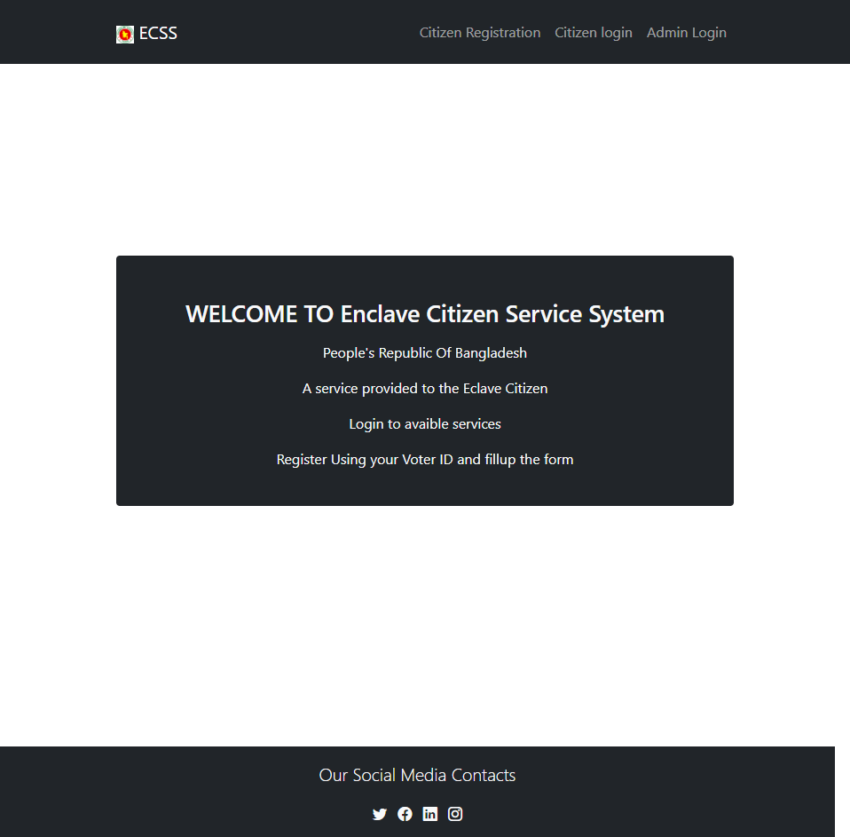

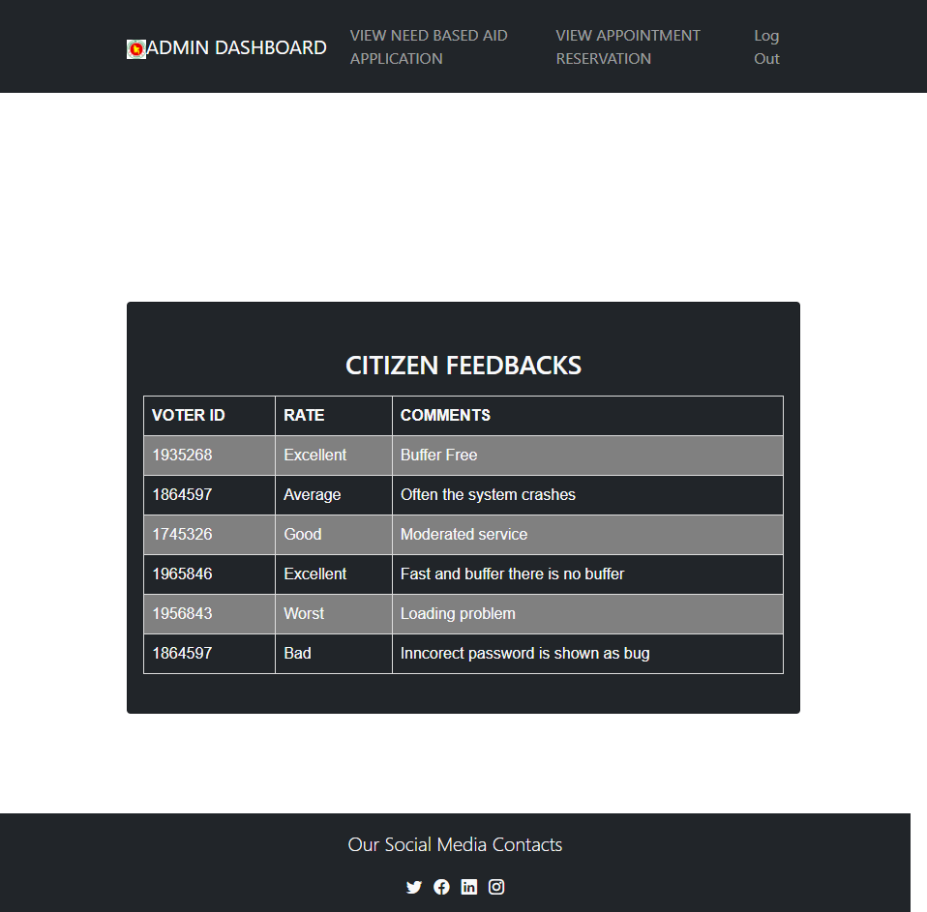
Enclave Citizen Service System
CSE307 Section 2 Summer 2022
SYED ALI REDWANUL HAIDER
ADIBA HAQUE
MD RAKIBUL HASAN

Slide 2

Project Overview
Enclave Citizen Service System

Slide 3

Functional Requirements .
Describing what ECSS does.
Admin can see and reject/accept Edit Citizen Information
Citizen can register for availing facilities
Citizen can view and edit information
Citizen can apply for “need Based Aids Health, Food &
Accommodation “
Citizen can Book and Cancel Appointment
Citizen can provide feedback
Admin can see “need Based Aids Health, Food & Accommodation “and see confirmation Email.
Admin can see “Appointment Booking “and seed
confirmation Email.
Admin can see and send response to Citizen’s Feedback

Slide 4
Nonfunctional Requirements.
Describing how ECSS does it
Performance Requirements
Security Requirements
Software Quality Attributes

Slide 5
Nonfunctional Requirement ctd.
Performance Requirements
Security – The system should not leave any cookies on the user’s computer containing the user’s password. The system’s back-end server shall only be accessible to authenticated management
Performance – The response time of the website should be minimal and should be able to handle heavy traffic
Maintainability – A RDBMS is used for maintaining the database and the software design is being done with modularity in mind so that maintainability can be done efficiently
Usability - The website’s interface must be user-friendly and easy to use
Supportability – The code and supporting modules of the system will be well documented and easy to understand

Slide 6
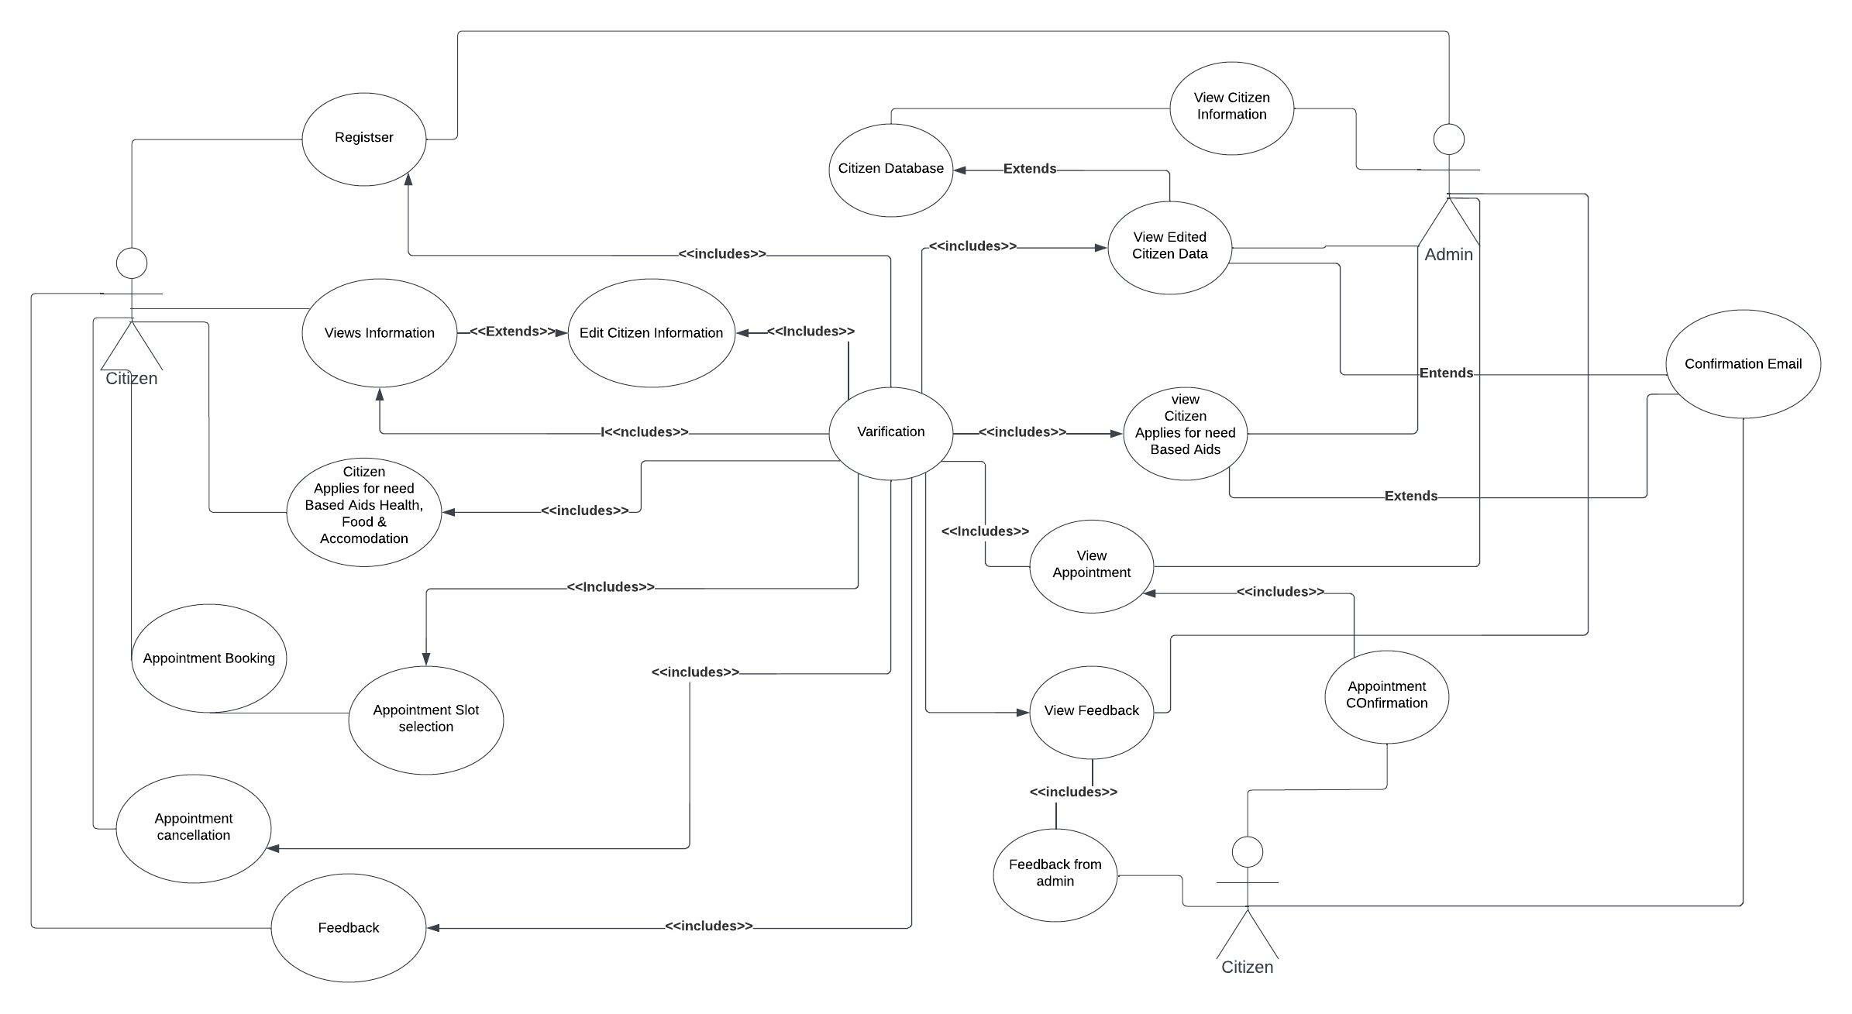
Use Case Diagram

Slide 7
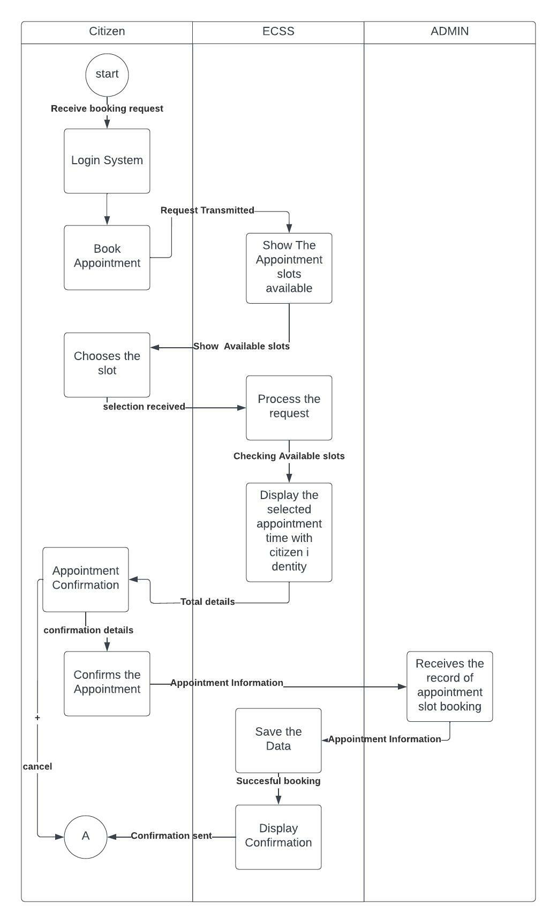
Activity Diagram

Slide 8
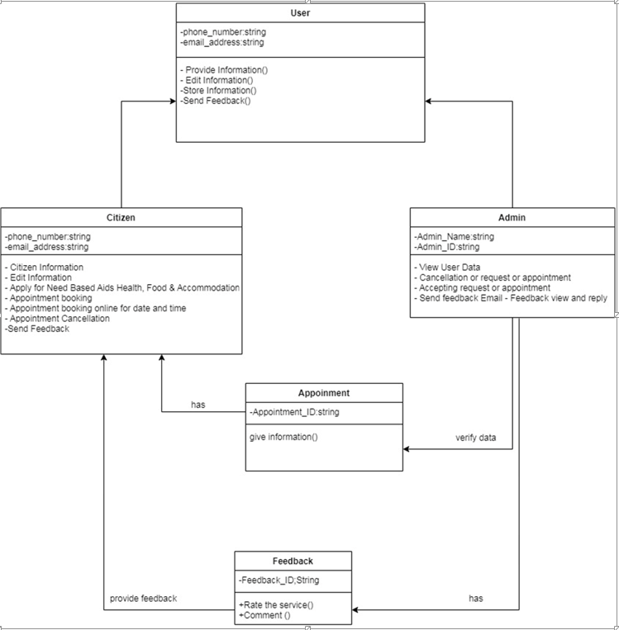
Class Diagram
Hyperlink: Class Diagram

Slide 9
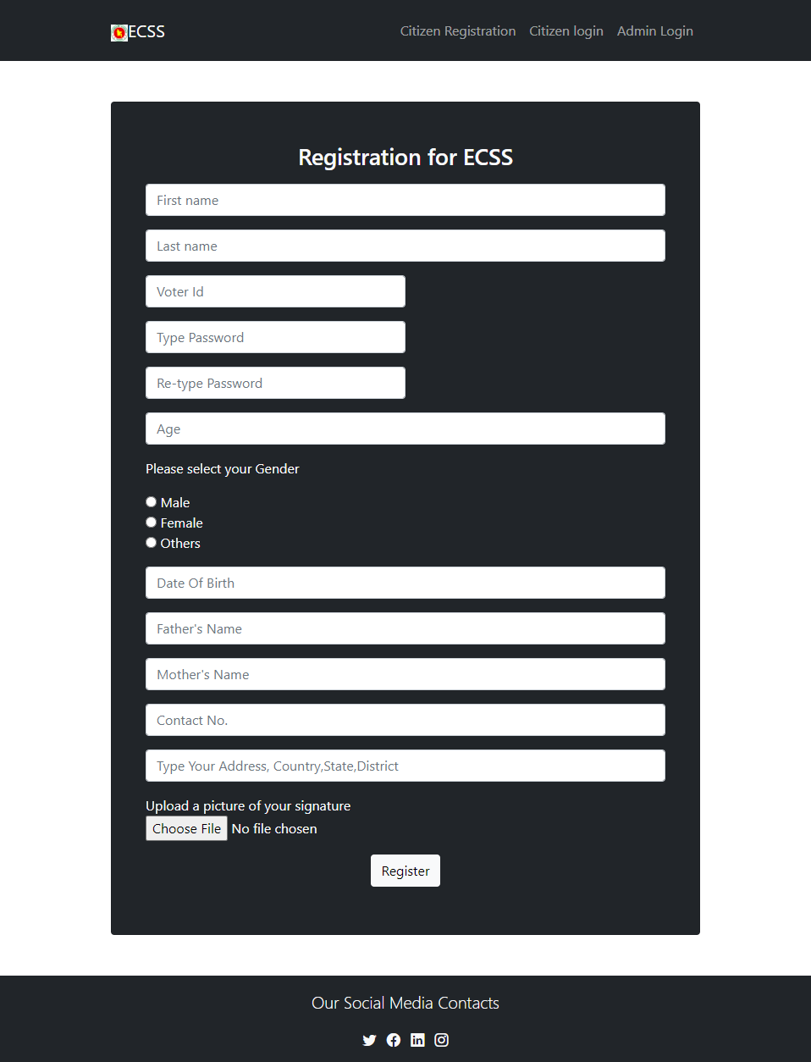

Slide 10
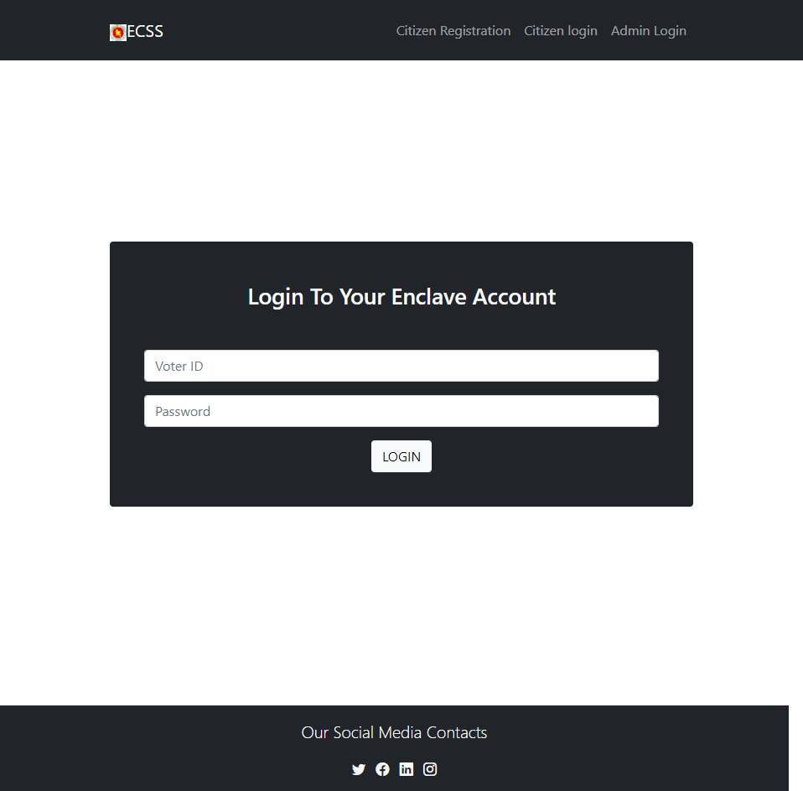


Slide 11
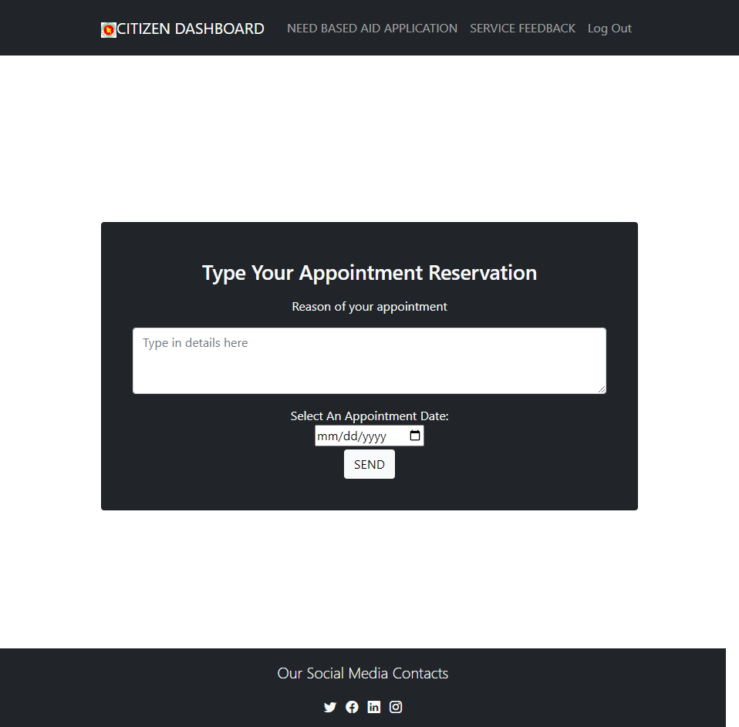
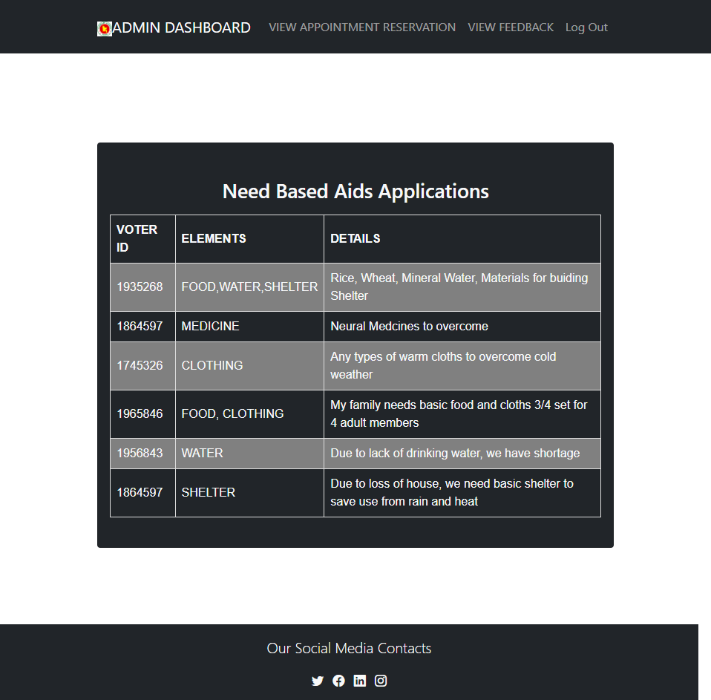

Slide 12
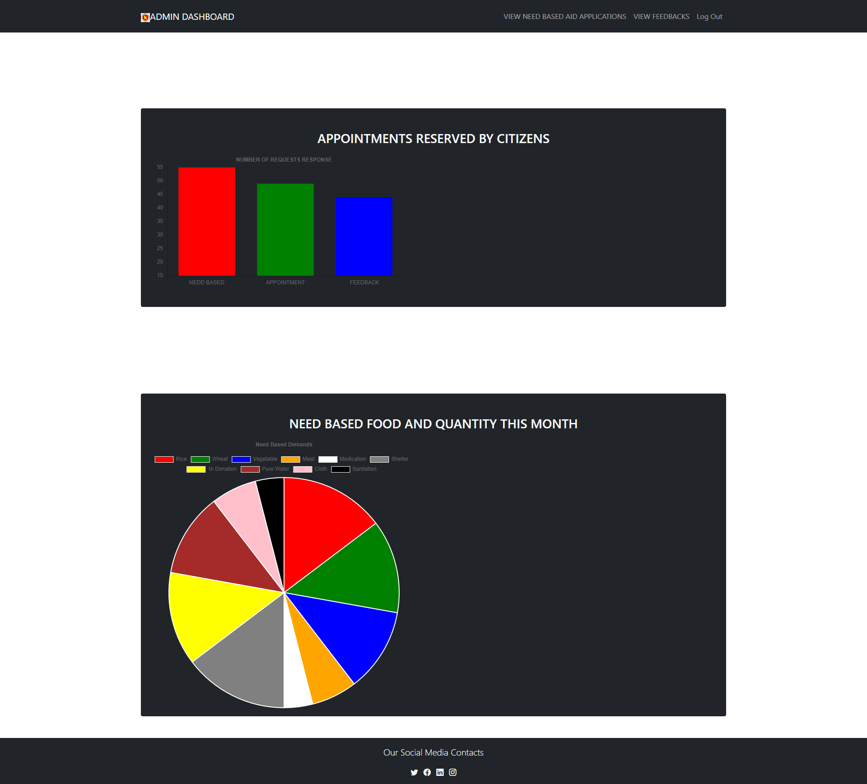

Slide 13
Thank You
By:
MD RAKIBUL HASAN
ADIBA HAQUE
SYED ALI REDWANUL HAIDER
Thanll you for your effort to guiding us till so far.
We are extremely grateful of you throughout this semester Miss! please give us an A, we tried very hard

